Slide 1


Slide 2
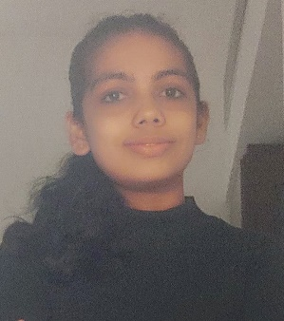
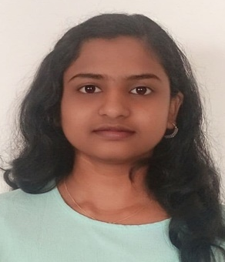
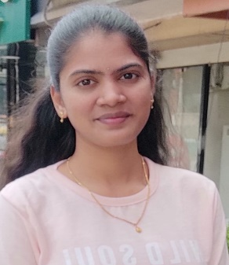
Project Highlights
Project Name : RGB LED FADER
Team Size : 3
BU Mentor Name : Rajesh Sola Mentor PS# 4001075
Madhura Subramanya Bhat
99003589
2002MYSEMB_F1
BE[ECE]
Harshitha D R
99003575
2002MYSEMB_F1
BE[EEE]
Mounika C H
99003595
2002MYSEMB_F1
BE[ECE]

Slide 3
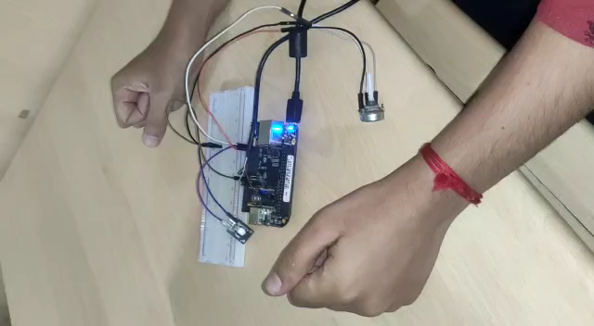
Project Video Snippet

Slide 4
Future development that can be implemented further
It can be implemented in LCD display
It can be implemented in CRT
Indoor and Outdoor lighting
They can be used in mobile applications

Slide 5


Thank You !

